Slide 1

One query language to rule them all (Node.js)
Vitaly Kozyura, SAP
May 15, 2020

Slide 2
Agenda
Introduction
SELECT / INSERT / UPDATE / DELETE
Advanced Features
API Usage Examples
Resources

Slide 3
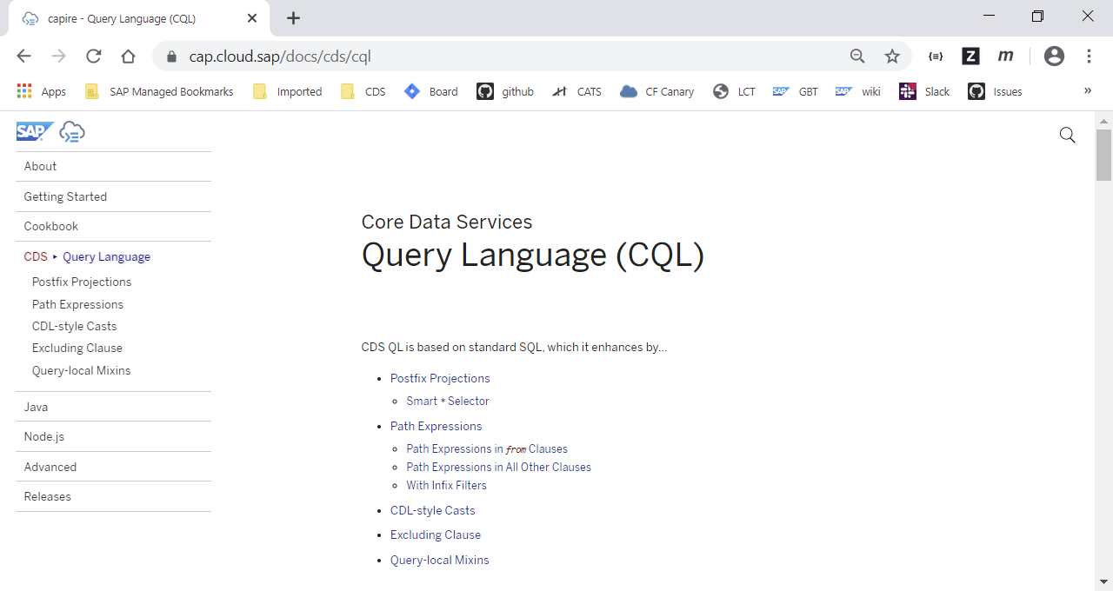

Slide 4
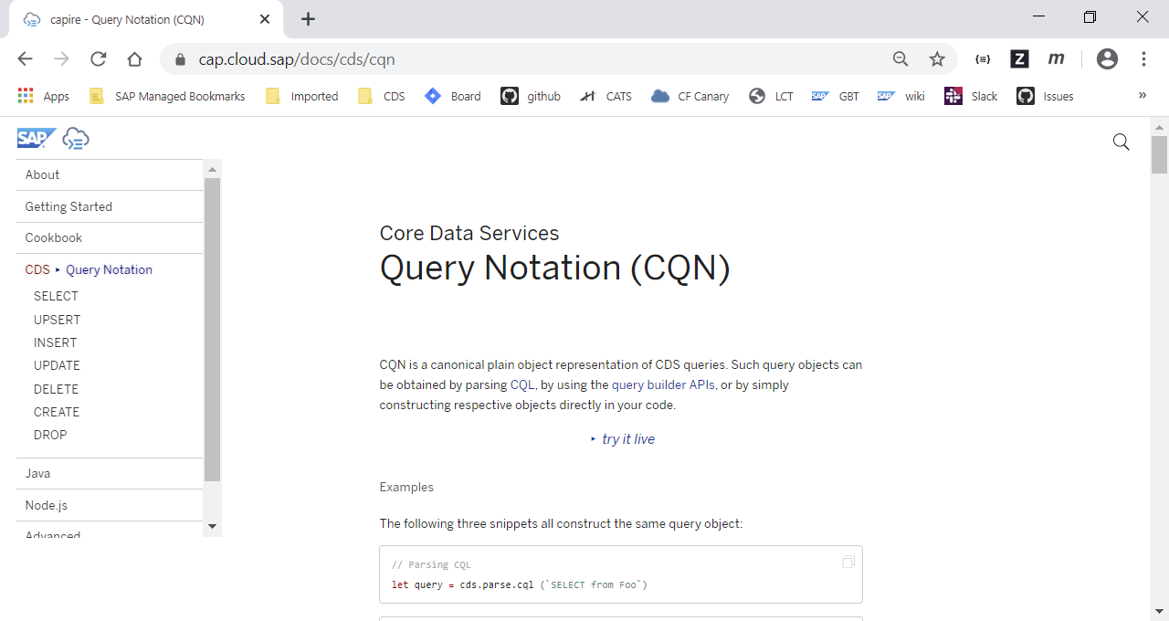

Slide 5
Introduction
OData / REST
OData / REST
CQL
SQL
CQN
Query API
(Node.js / Java)
NoSQL
Canonical representation of CQL
DB / Service agnostic format
Can be efficiently built using Query API

Slide 6
Introduction
OData / REST
OData / REST
CQL
SQL
CQN
Query API
(Node.js / Java)
NoSQL
Canonical representation of CQL
DB / Service agnostic format
Can be efficiently built using Query API
CQL:
SELECT from Authors where ID = 1
CQN:
SELECT: { from: { ref: ['Authors'] }, where: [{ ref: ['ID'] }, '=', { val: 1 }] }
Query API: SELECT.from('Authors', 1)

Slide 7
CQN: SELECT / INSERT / UPDATE / DELETE
SELECT SELECT: { from: { ref: ['Test'] }, where: [{ ref: ['ID'] }, '=', { val: 1 }] } | UPDATE UPDATE: { entity: 'Test', data: { value: 1 }, where: [{ ref: ['ID'] }, '=', { val: 1 }] }
INSERT INSERT: { into: 'Test’, entries: [{ ID: 1 }] } | DELETE DELETE: { from: 'Test', where: [{ ref: ['ID'] }, '=', { val: 1 }] }

Slide 8
CDS Model
entity Books {
key ID : Integer;
title : localized String; year : Integer;
author : Association to Authors;
}
entity Authors {
key ID : Integer;
name : String;
books : Composition of many Books;
}

Slide 9
SELECT .from
entity Books {
key ID : Integer;
title : localized String; year : Integer;
author : Association to Authors;
}
entity Authors {
key ID : Integer;
name : String;
books : Composition of many Books;
}
CDS MODEL
CQL:
SELECT from Authors where ID = 1
Query API:
SELECT.from('Authors', 1)
CQL:
SELECT from Authors { name }
where ID = 1
Query API:
SELECT.from('Authors', 1, a => a.name)

Slide 10
SELECT .columns
entity Books {
key ID : Integer;
title : localized String; year : Integer;
author : Association to Authors;
}
entity Authors {
key ID : Integer;
name : String;
books : Composition of many Books;
}
CDS MODEL
CQL:
SELECT from Authors { ID, name }
Query API:
SELECT.from('Authors')
.columns(a => { a.ID, a.name })
Query API:
SELECT.from('Authors')
.columns(['ID', 'name'])

Slide 11
SELECT .one / .distinct
entity Books {
key ID : Integer;
title : localized String; year : Integer;
author : Association to Authors;
}
entity Authors {
key ID : Integer;
name : String;
books : Composition of many Books;
}
CDS MODEL
CQL:
SELECT one from Authors
Query API:
SELECT.one('Authors')
CQL:
SELECT distinct from Authors
Query API:
SELECT.distinct('Authors')

Slide 12
SELECT .byKey
entity Books {
key ID : Integer;
title : localized String; year : Integer;
author : Association to Authors;
}
entity Authors {
key ID : Integer;
name : String;
books : Composition of many Books;
}
CDS MODEL
CQL:
SELECT from Authors where ID = 1
Query API:
SELECT.from('Authors').byKey(1)
Query API:
SELECT.from('Authors').byKey({ID: 1})

Slide 13
.where Object Predicate and Fluent Notation
entity Books {
key ID : Integer;
title : localized String; year : Integer;
author : Association to Authors;
}
entity Authors {
key ID : Integer;
name : String;
books : Composition of many Books;
}
CDS MODEL
CQL:
SELECT from Authors
where name = 'Name' and (ID = 1 or ID = 2)
Query API (Object Predicate):
SELECT.from('Authors')
.where({ name: 'Name', or: [{ID: 1}, {ID: 2}] })
Query API (Fluent Notation):
SELECT.from('Authors')
.where('name = ', 'Name', 'and (ID =', 1, 'or ID =', 2, ')')

Slide 14
.where / .and / .or
entity Books {
key ID : Integer;
title : localized String; year : Integer;
author : Association to Authors;
}
entity Authors {
key ID : Integer;
name : String;
books : Composition of many Books;
}
CDS MODEL
Query API
SELECT.from('Authors')
.where({ name: 'Name', or: [{ID: 1}, {ID: 2}] })
.where('name != ', 'Name1')
.and([{ ref: ['ID'] }, '=', { val: 1 }])
.or('name = ', 'Name2') )

Slide 15
SELECT .groupby / .orderby
entity Books {
key ID : Integer;
title : localized String; year : Integer;
author : Association to Authors;
}
entity Authors {
key ID : Integer;
name : String;
books : Composition of many Books;
}
CDS MODEL
CQL:
SELECT from Authors group by name
Query API:
SELECT.from('Authors')
.groupby('name')
CQL:
SELECT from Authors order by name
Query API:
SELECT.from('Authors')
.orderby('name')

Slide 16
SELECT .having / .limit
entity Books {
key ID : Integer;
title : localized String; year : Integer;
author : Association to Authors;
}
entity Authors {
key ID : Integer;
name : String;
books : Composition of many Books;
}
CDS MODEL
CQL:
SELECT from Authors
group by name having ID > 1
Query API:
SELECT.from('Authors') .groupby('name').having('ID >', 1)
CQL:
SELECT from Authors limit 100 offset 2
Query API:
SELECT.from('Authors').limit(100, 2)

Slide 17
INSERT
entity Books {
key ID : Integer;
title : localized String; year : Integer;
author : Association to Authors;
}
entity Authors {
key ID : Integer;
name : String;
books : Composition of many Books;
}
INSERT.into('Authors')
.entries([{ ID: 1, name: 'Name' }])
INSERT.into('Authors') .columns('ID', 'name') .values(1, 'Name')
INSERT.into('Authors')
.columns('ID', 'name')
.rows([ [1, 'Name 1'], [2, 'Name 2'] ])
CDS MODEL

Slide 18
UPDATE
entity Books {
key ID : Integer;
title : localized String; year : Integer;
author : Association to Authors;
}
entity Authors {
key ID : Integer;
name : String;
books : Composition of many Books;
}
CDS MODEL
UPDATE (Authors)
.with({ name: 'Changed Name' })
.byKey(1))

Slide 19
DEEP UPDATE
entity Books {
key ID : Integer;
title : localized String; year : Integer;
author : Association to Authors;
}
entity Authors {
key ID : Integer;
name : String;
books : Composition of many Books;
}
CDS MODEL
UPDATE (Authors)
.with(
{
name: 'Changed Name',
books: [{
ID: 100,
title: 'Title‘,
year: 2020,
author_ID: 1
}]
})
.where('ID =', 1))

Slide 20
DELETE
entity Books {
key ID : Integer;
title : localized String; year : Integer;
author : Association to Authors;
}
entity Authors {
key ID : Integer;
name : String;
books : Composition of many Books;
}
CDS MODEL
DELETE.from('Authors').byKey(1)

Slide 21
Expand
entity Books {
key ID : Integer;
title : localized String; year : Integer;
author : Association to Authors;
}
entity Authors {
key ID : Integer;
name : String;
books : Composition of many Books;
}
CDS MODEL
CQL:
SELECT from Authors { ID, name, books.title }
Query API:
SELECT.from('Authors')
.columns(a => { a.ID, a.name,
a.books(b => b.title) })

Slide 22
Sub Select
entity Books {
key ID : Integer;
title : localized String; year : Integer;
author : Association to Authors;
}
entity Authors {
key ID : Integer;
name : String;
books : Composition of many Books;
}
CDS MODEL
CQL:
SELECT from Authors
where exists SELECT one from Test
Query API:
SELECT.from('Authors‘)
.where('exists', SELECT.one('Test'))

Slide 23
API Usage
Custom Handlers
srv.before('CREATE', 'Books', req => {
const tx = cds.transaction(context)
await tx.run( UPDATE('Test').with({ created: 1 }) .where('ID =', 1)) })
Consuming Services
const AdminService = await cds.connect.to('AdminService‘)
const query = SELECT.from('Authors', a => { a.name } )
.where(`name like`, 'E%‘)
const authors = await AdminService.run(query)

Slide 24
Resources
Documentation
https://cap.cloud.sap/docs/node.js/api#cds-ql
Samples and Tests
https://github.com/SAP-samples/cloud-cap-samples

Slide 25
Thank you.
Contact information:
Vitaly Kozyura
v.kozyura@sap.com

